Slide 1
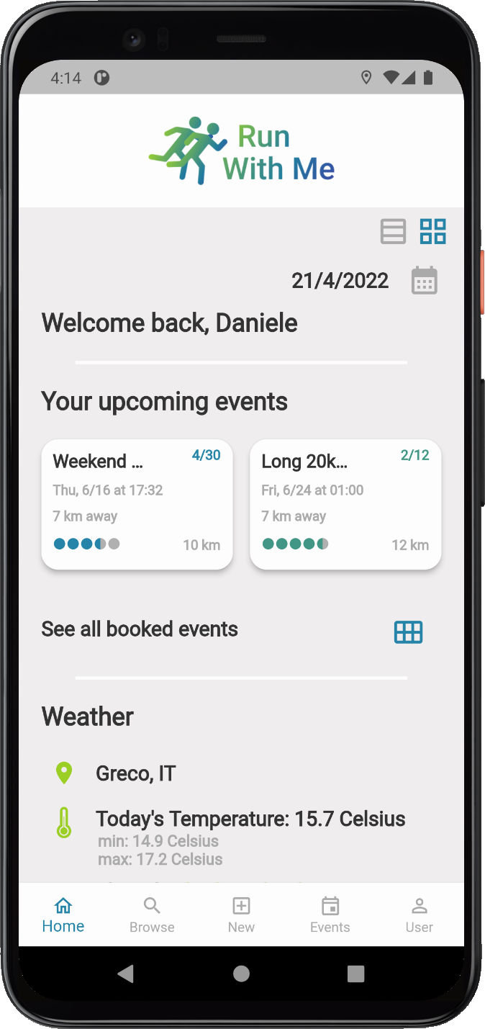



A mobile application built in Flutter to find friends to run with.
DIMA Project Presentation - 17/06/2022
Federico Dei Cas Daniele De Vincenti

Slide 2
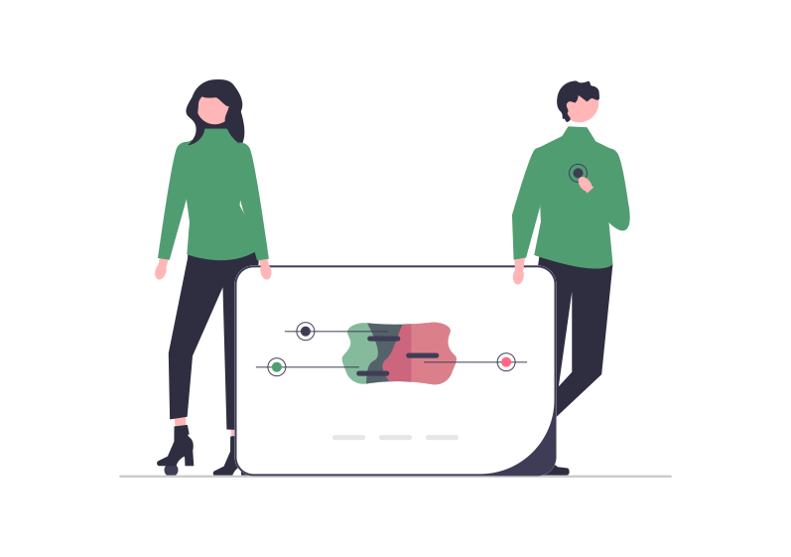
INDEX
INTRODUCTION
What is it for?
High-level Architectural view
DESIGN CHOICES
Multithreading
Authentication
USER INTERFACE
Layout and Themes
FUNCTIONALITIES
TESTING
Unit, Widget/UI and Integration Testing
API Testing

Slide 3
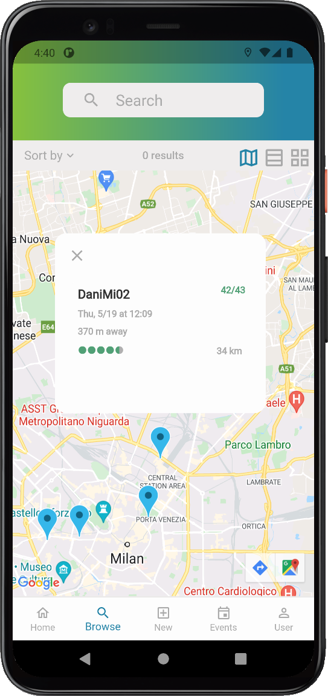
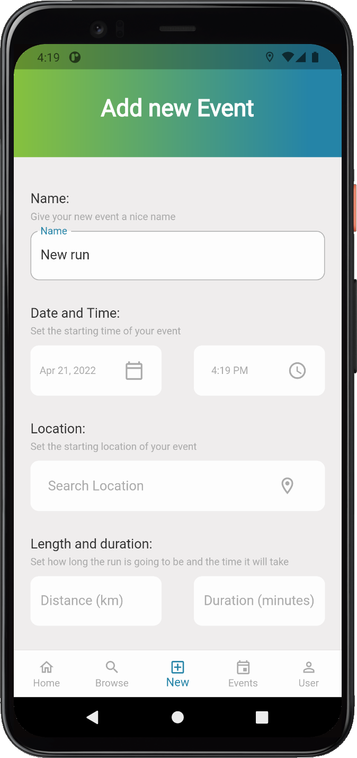
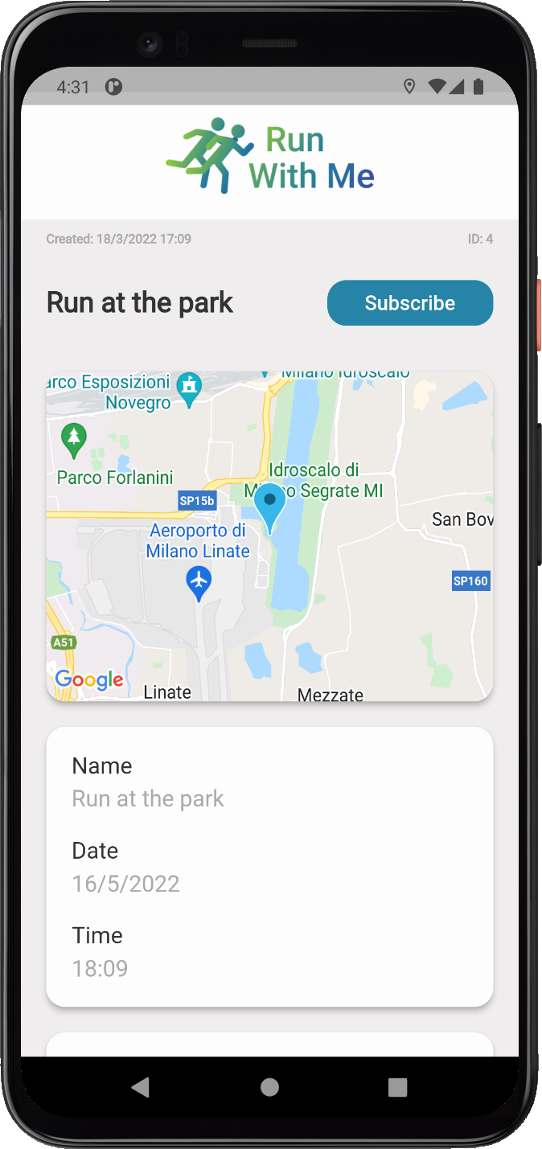
WHAT IS IT FOR?
Search for running events near you
Propose an event
Subscribe to an event
Make new friends!

Slide 4
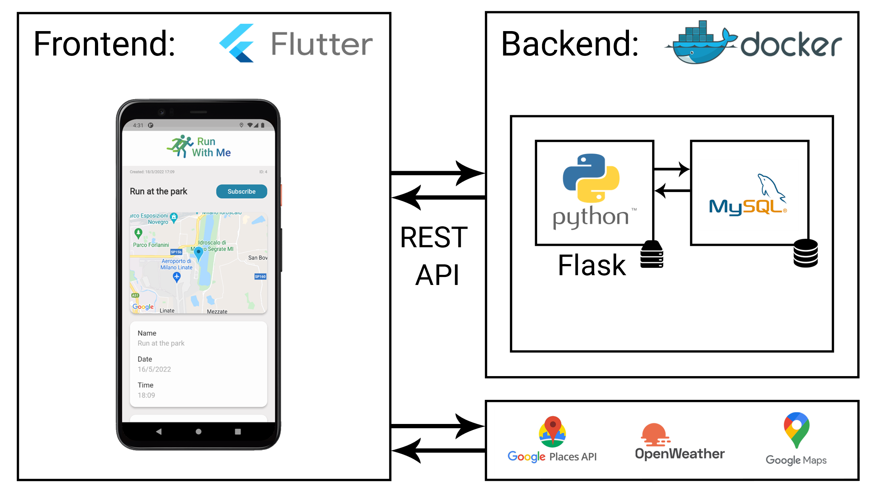
HIGH-LEVEL ARCHITECTURAL VIEW
For the frontend we chose Flutter for:
performance and stability
single codebase for different platforms.
For the backend we chose a custom solution for:
versatility and full control over our application
Best integration with external services to combine useful features like maps.

Slide 5
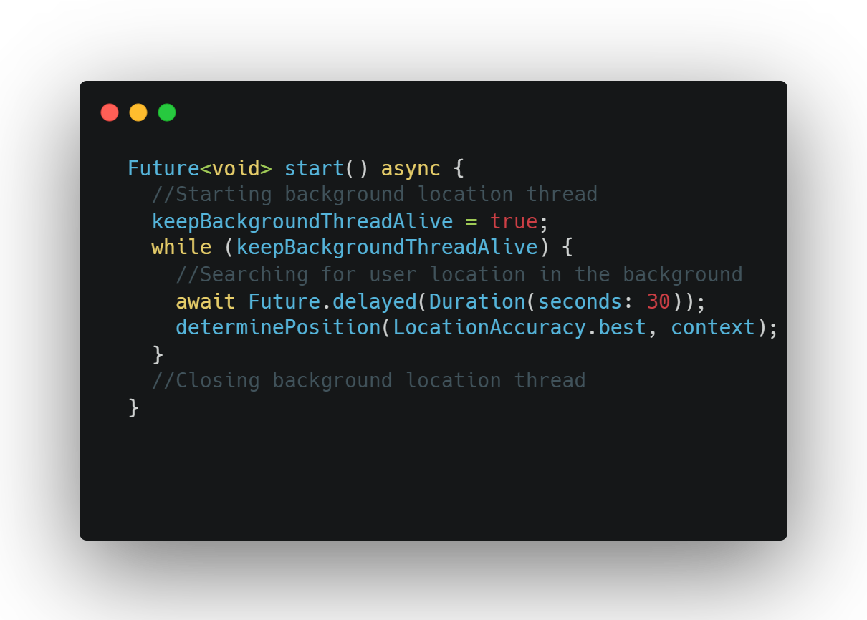
MULTITHREADING
The app was designed to support multithreading, because we must support the interaction with external services and guarantee an interactive UI while making requests.
Multithreading was also needed to continuously update the user current position.

Slide 6




AUTHENTICATION
JWT authentication tokens are generated for users. JWTs have an expiration time set by the backend, so user credentials are stored on the client to generate a tokens when they expire. The credentials stored locally on the device are encrypted using flutter secure storage plugin.
+

Slide 7
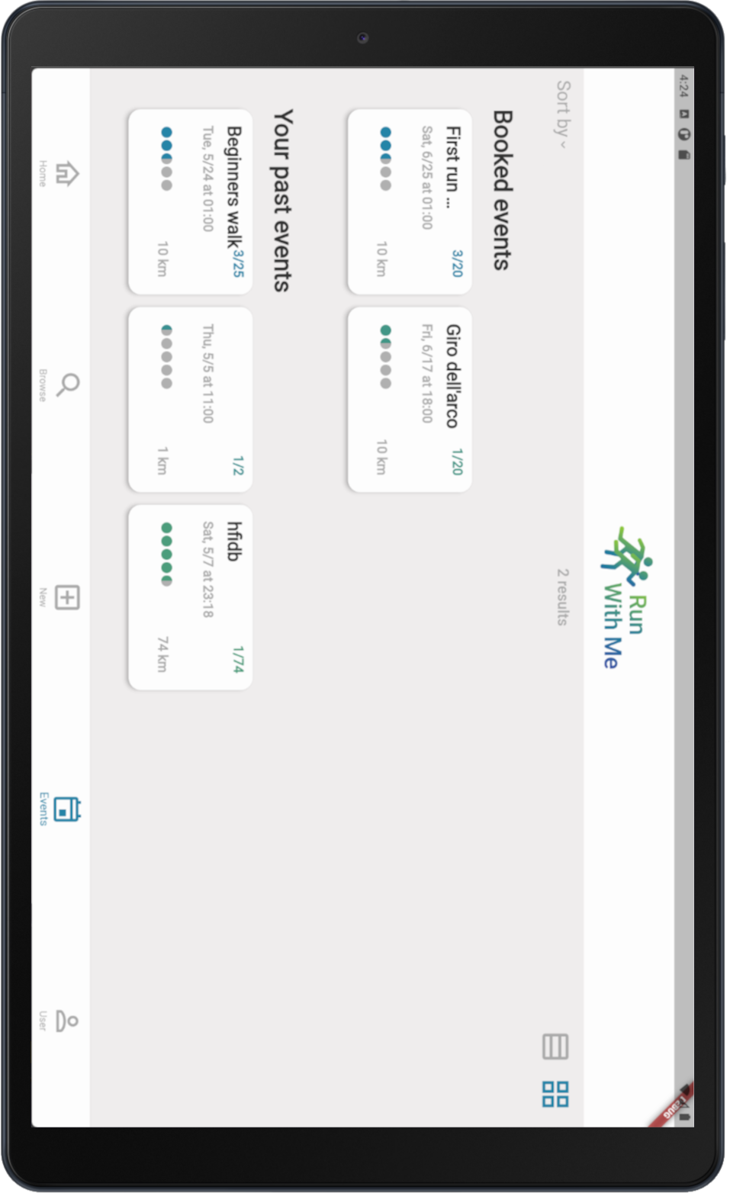
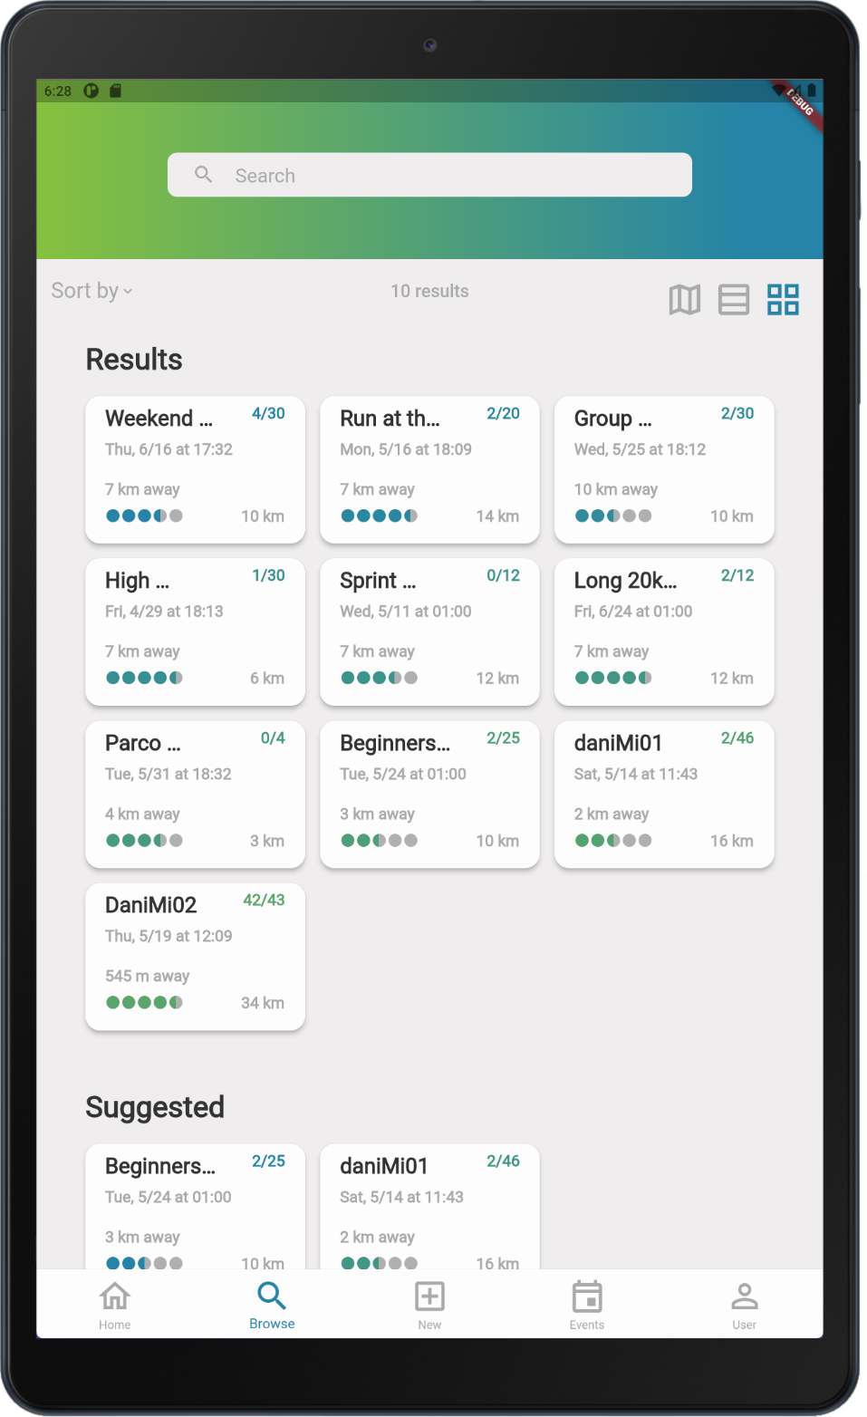
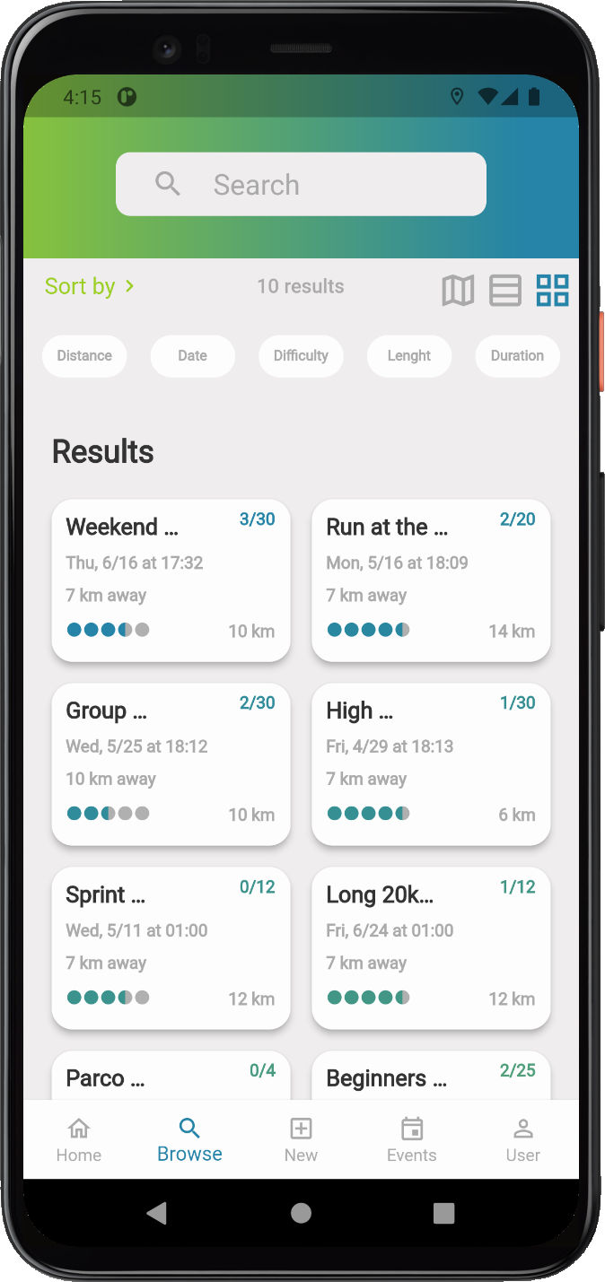
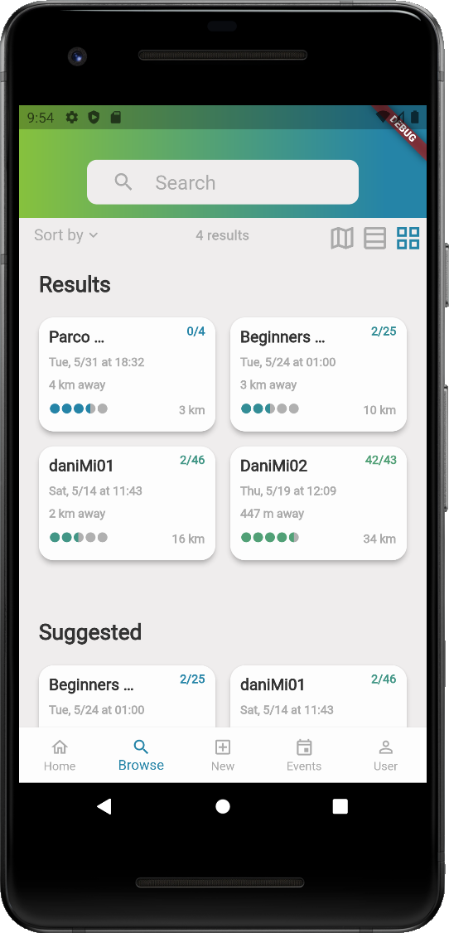
LAYOUT
Support for different screen sizes, from smaller phones, to bigger tablets.
UI was built with relative sizes depending on screen height and width.
Carefully developed a design system to provide a modern look and feel:
Custom fonts and colors
Custom UI elements, taking advantage of flutter widgets reusability.

Slide 8
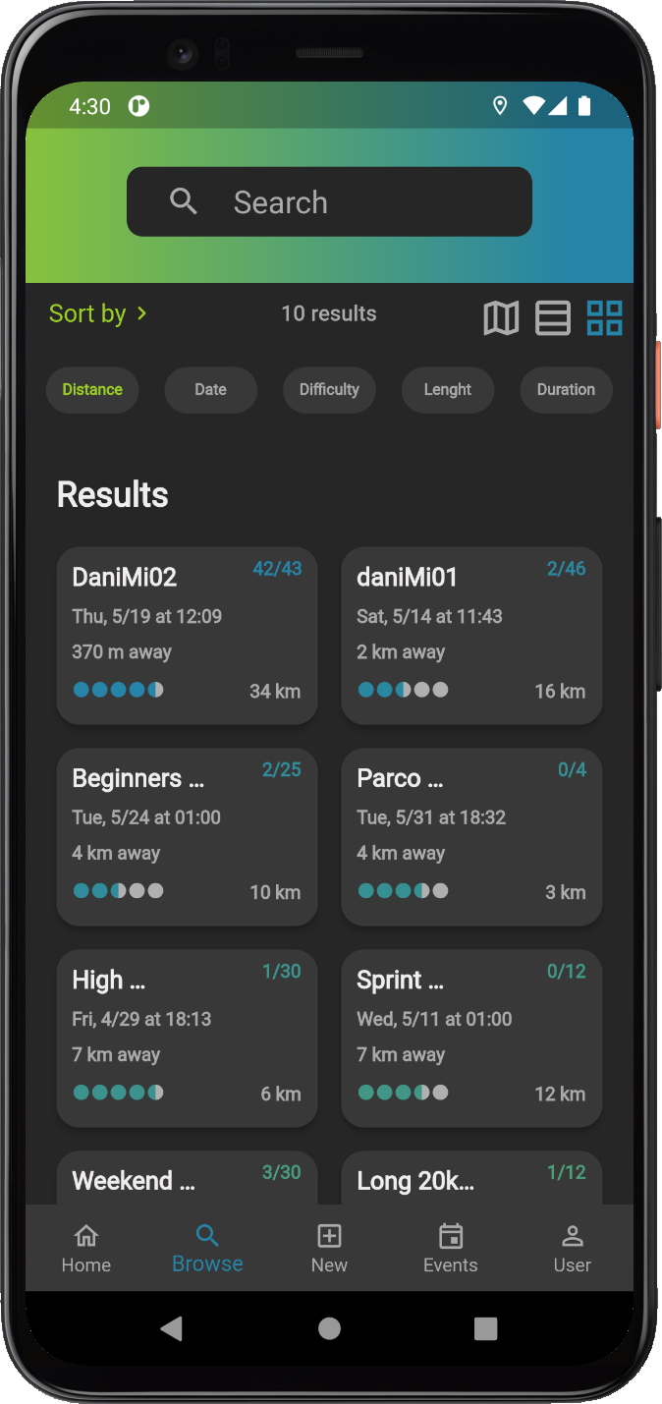
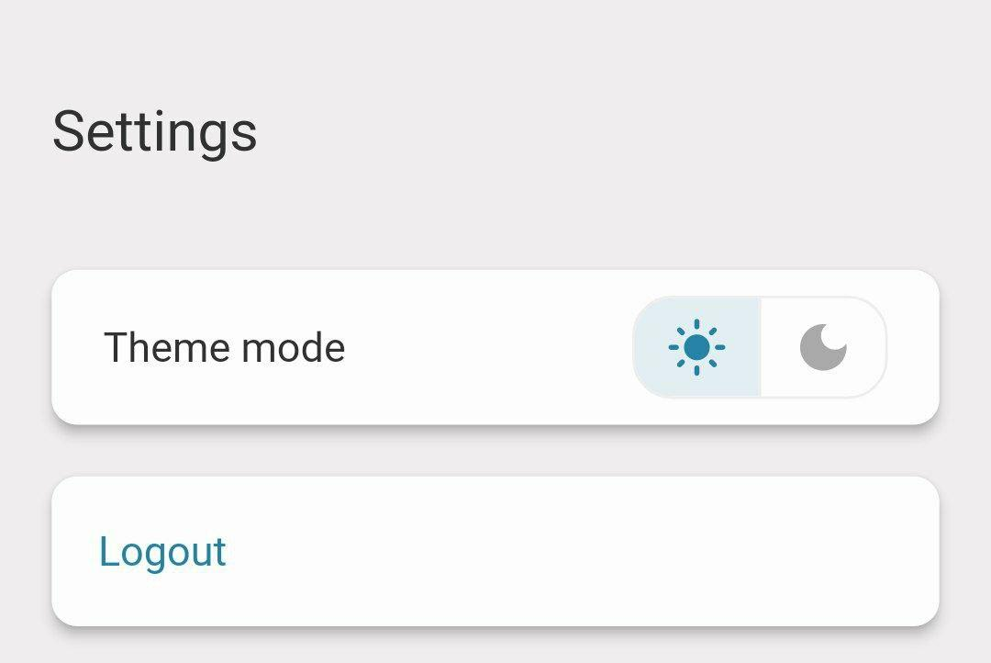
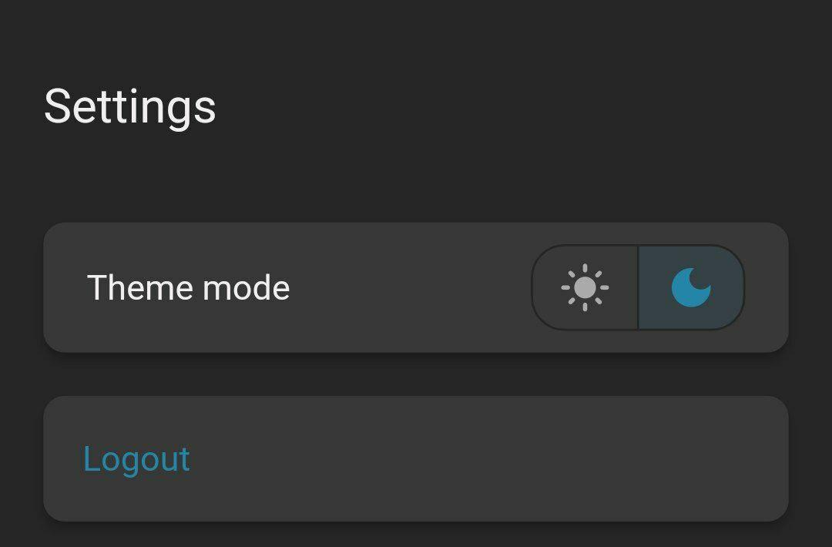
THEMES
Support for multiple theme modes:
Light Theme
DarkTheme
Just go to the user page, setting section and toggle your preferred mode.

Slide 9
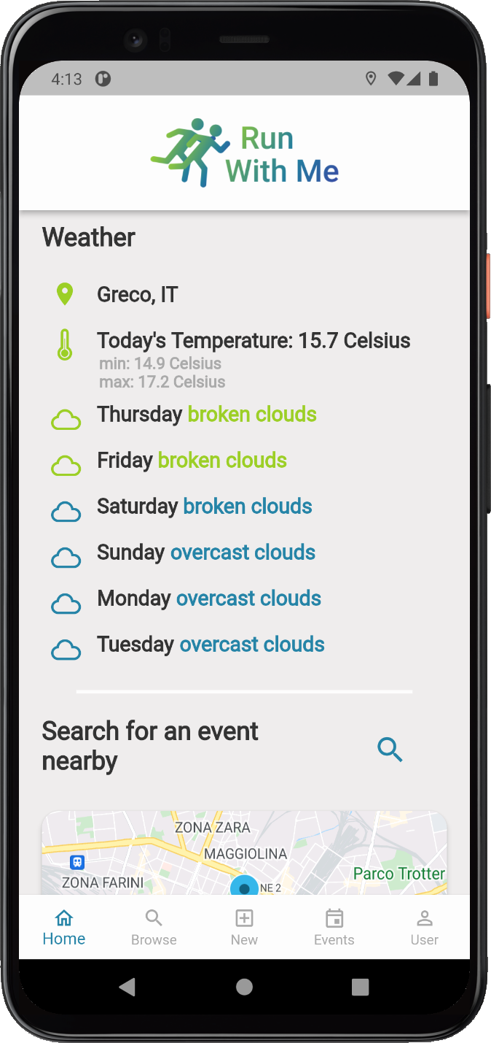
HOME
Home page features:
Weather forecasts based on user location
Recap of user’s upcoming events that he subscribed to
Stats for the last 7 days
Recap of past events

Slide 10
BROWSE EVENTS
User can:
search for events nearby
search by location
browse suggested events
Events are also suggested based on user fitness level. Recently viewed event section stores the last 10 events checked by the user. Even when not registered, users can still browse and view events.

Slide 11
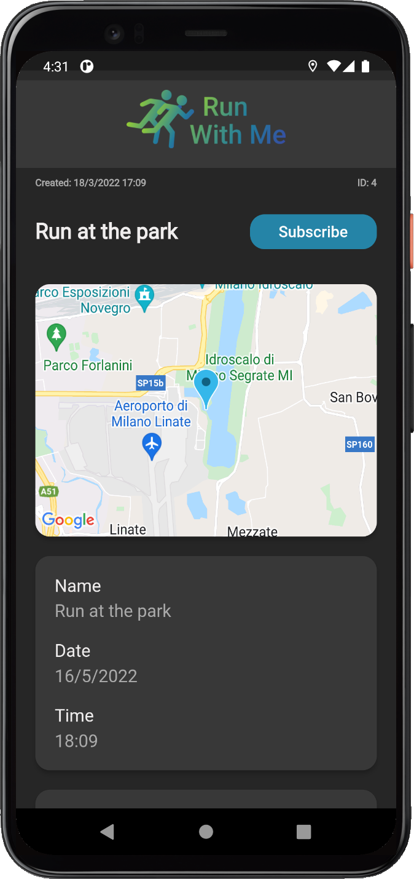
EVENT DETAILS
Once you found an interesting event, You can open it to view all details, including:
Event name
Date
Time
Starting point
Difficulty Level (between 0-5)
Current participants
Maximum allowed participants

Slide 12
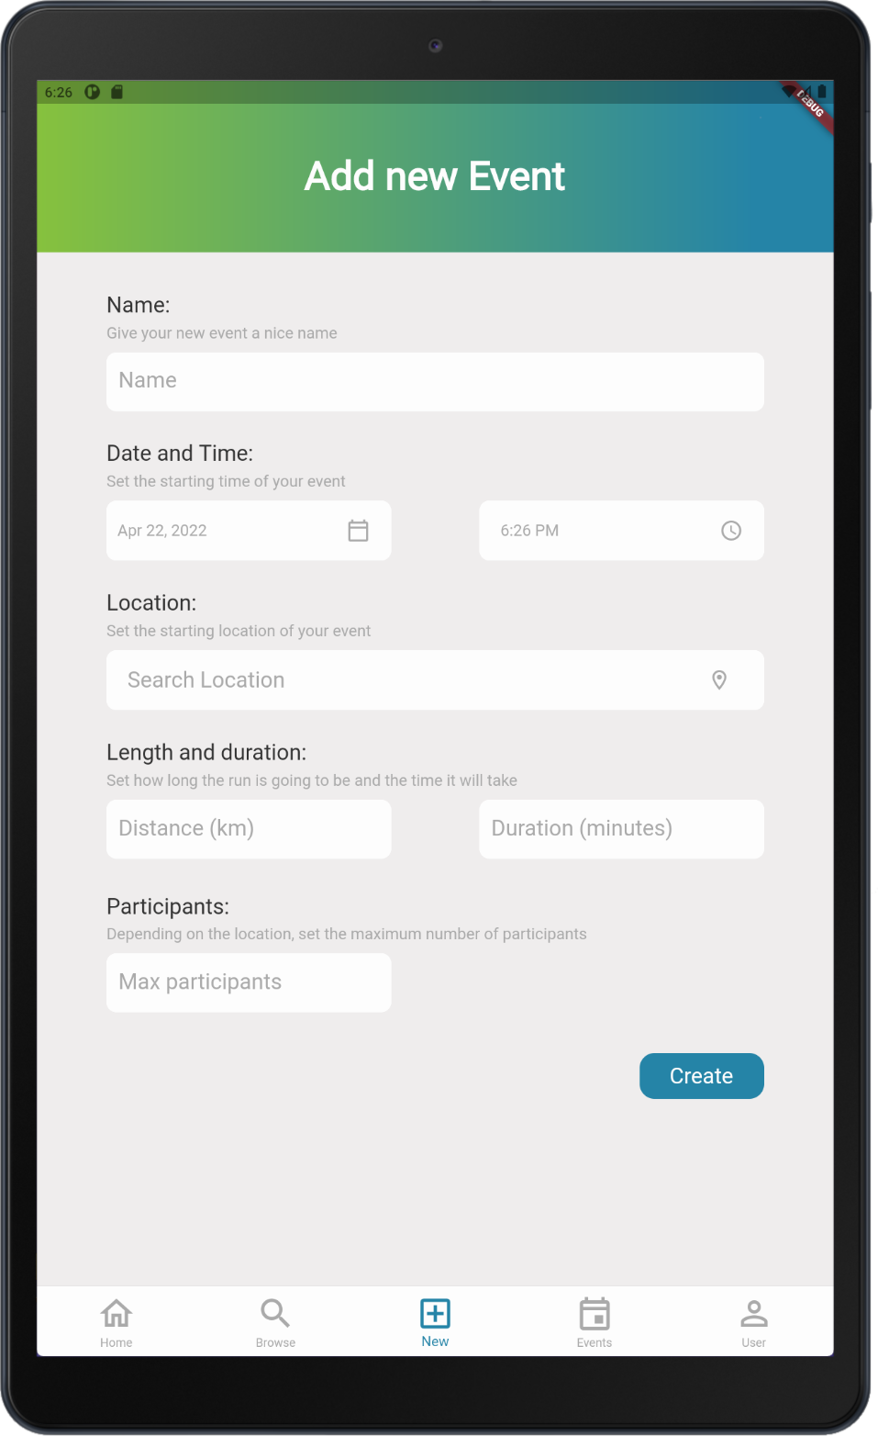
CREATE EVENT
Give your event a name
Set date and time
Choose the starting location
Define a duration
Define a length in kms
Set a maximum number of participants

Slide 13
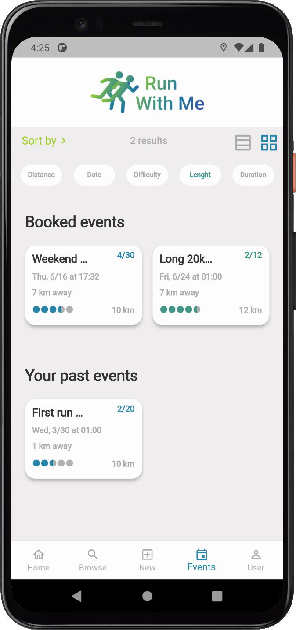
BOOKED EVENTS
Once subscribed to an event, the user can check all the events he’s attending to in the Events tab.
After an event has passed, it will be automatically moved in the Past Event section.

Slide 14
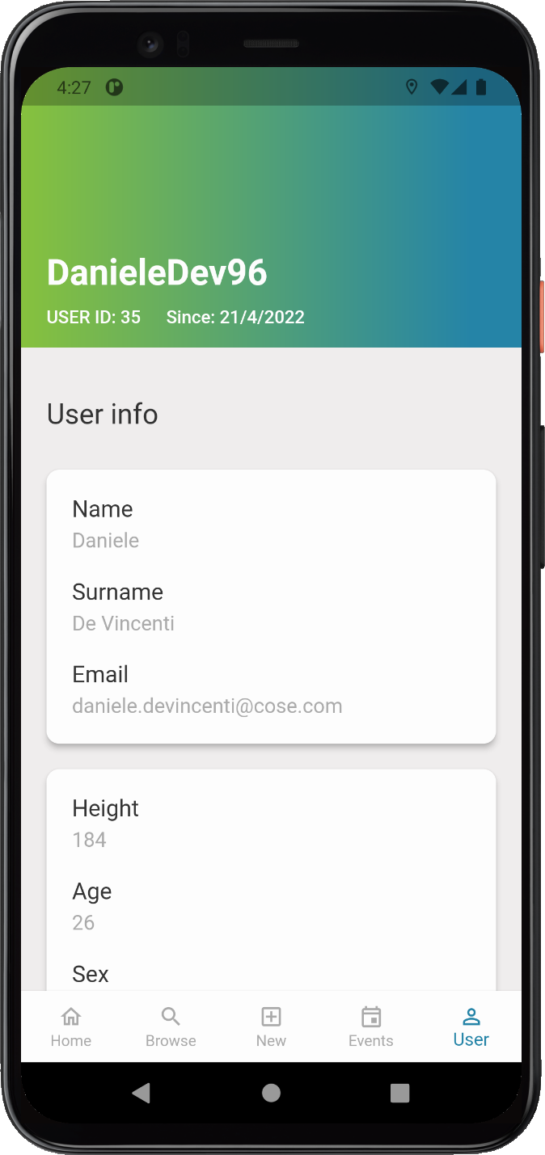
USER
Here the user you can check all his info and access settings.
Informations are organized in different cards for better readability.
In the settings section, users can select theme mode or log out of the application

Slide 15
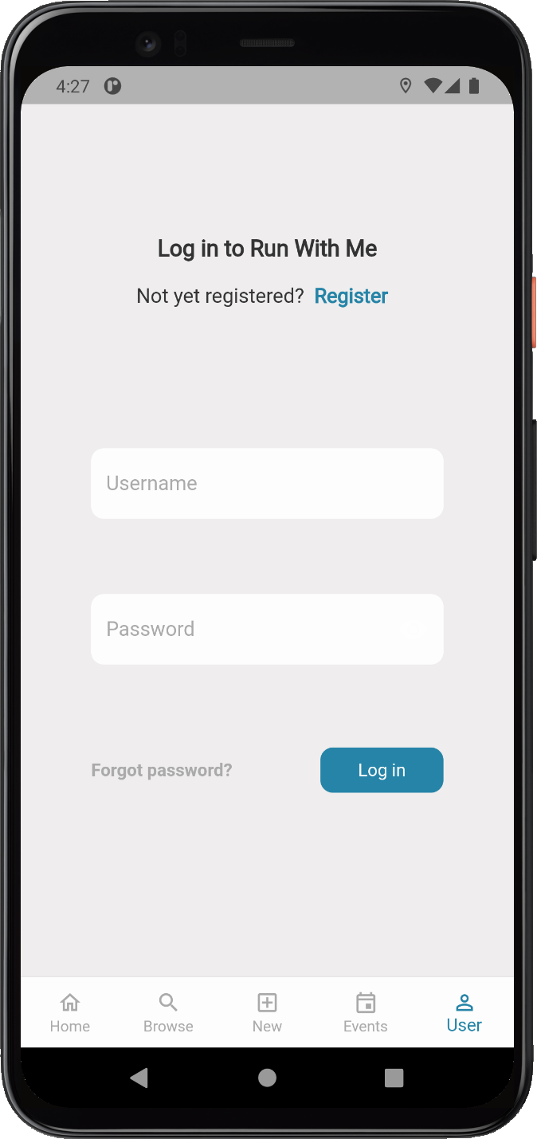
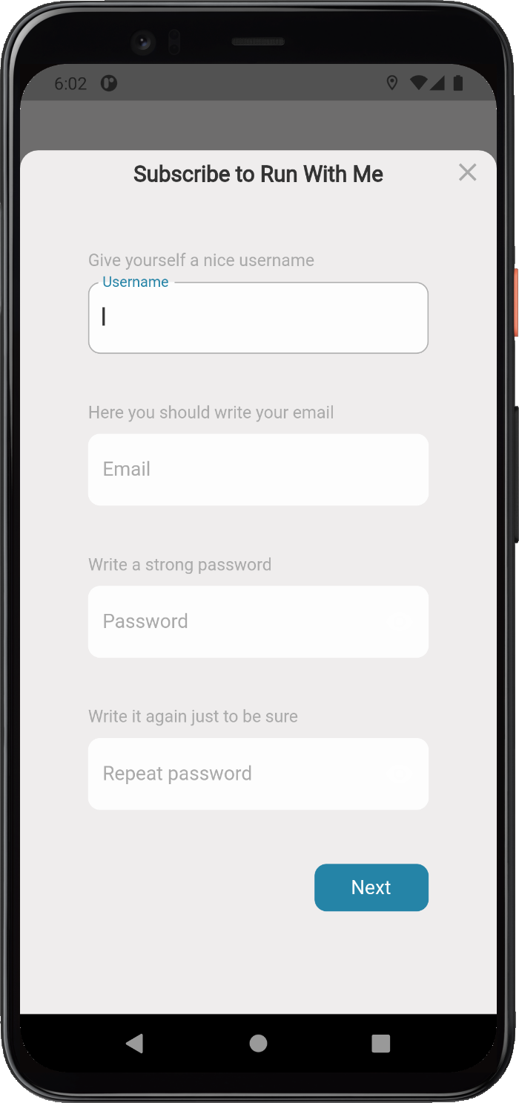
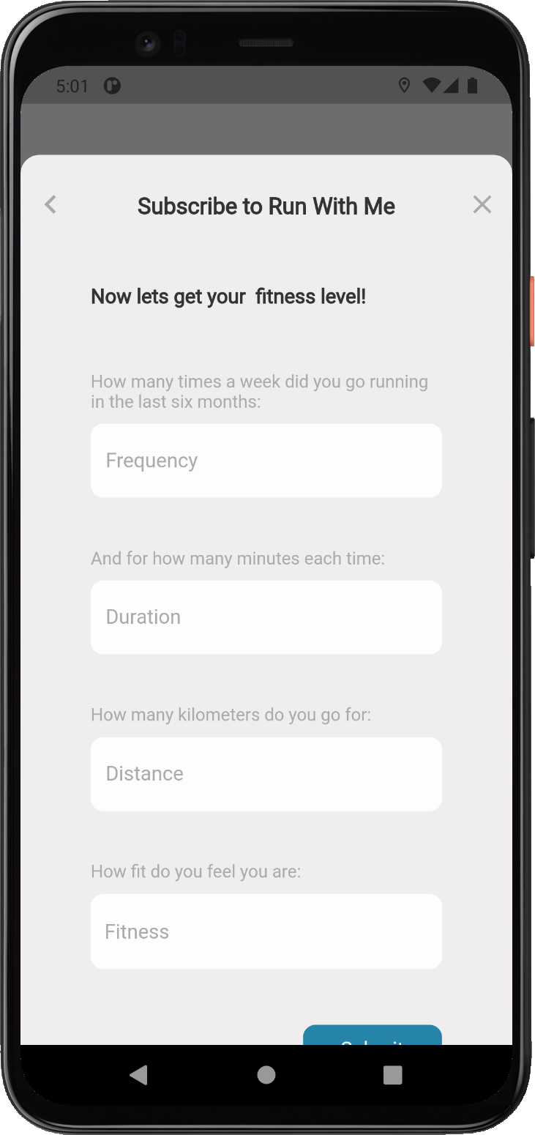
AUTHENTICATION
While subscribing to RunWithMe the user is asked some easy questions that are used to calculate a fitness level.
This fitness level will then be used to show suggested events.

Slide 16
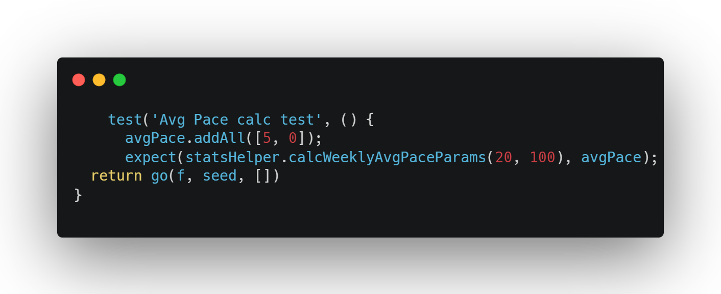
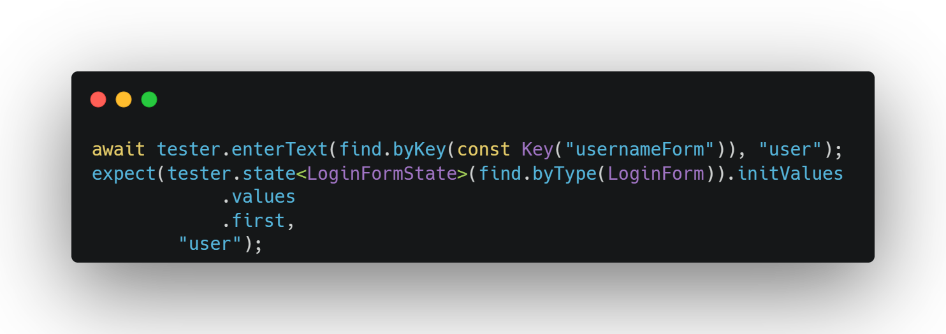
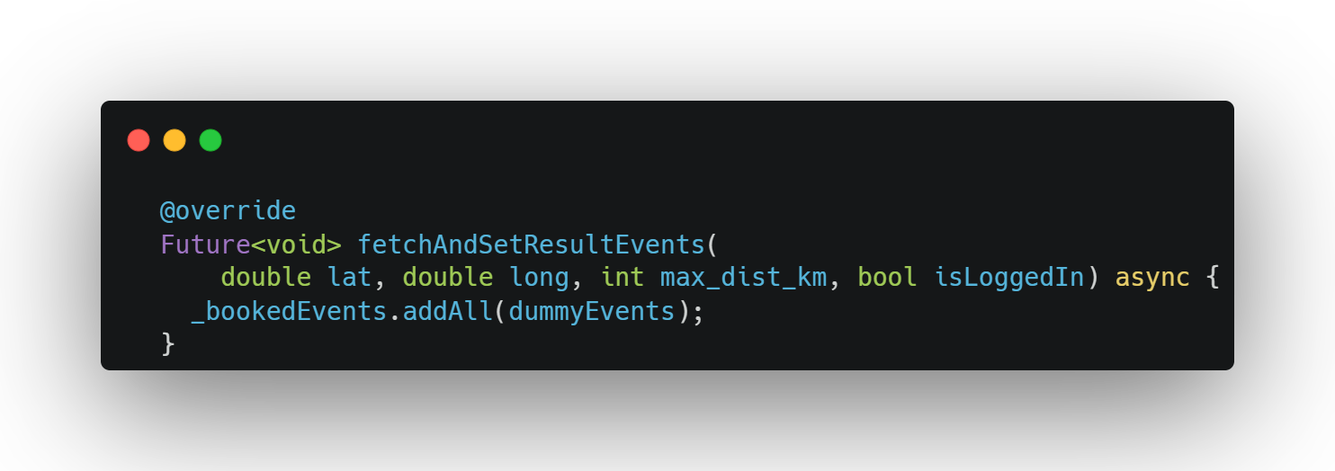
TESTING - 1
MANUAL TESTING
Some tests were done manually, like testing the UI in different screen sizes, or testing usability.
UNIT TESTING
Unit testing were used to test mainly our dart classes that are independent from Flutter.

Slide 17
TESTING - 2
WIDGET/UI TESTING
Widgets were tested in isolation to check the state and that ui elements were built correctly.
INTEGRATION TESTING
To test the components integration, like screens, mock classes of all providers had to be created, that instead of actually making HTTP requests would return dummy data.

Slide 18
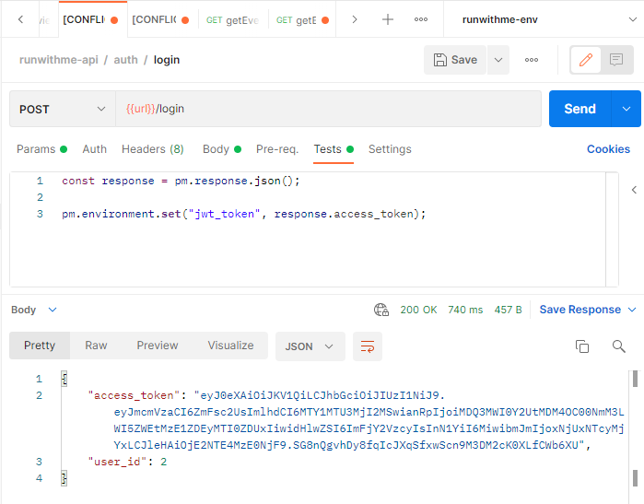
TESTING - 3
API TESTING
As we developed our app and our backend at the same time. We needed to test all our API endpoints independently of the app. This testing phase was done with Postman, first within our local environments and then within a VPS reachable from the internet. We used a post-request script to assign the auth token as environment variable and attach it to the header of other requests.

Slide 19

THANKS FOR WATCHING!
NOW IT’S TIME FOR A DEMO

